Slide 1
Chicago Crime Data set
Predicting FUTURE Crime in Chicago
CLUSTERING PROBLEM – Robert, Arun, YARA, Don, ARNAB

Slide 2
Dataset selection
Pulled from Kaggle
Includes demographic information
Identify Instance, Target, and Possible Features
Instances: 678,000
Target: Criminal Rate Hot Spots
Possible Features: 20 Features

Slide 3
Data description
Case_Number: Numerical
Date: Numerical
Block: Categorical
Primary_Type: Categorical
Description: Categorical
Location_Description: Categorical
Arrest: Categorical
Year: Numerical

Slide 4
Data ingestion
Stand-alone CSV
Import directly from CSV via Python
Convert to to DataFrame in Pandas
Describe and explore data to determine if any data is missing or bad

Slide 5
Data wrangling
No missing values
“Clean data”
Already normalized in tabular format structure

Slide 6
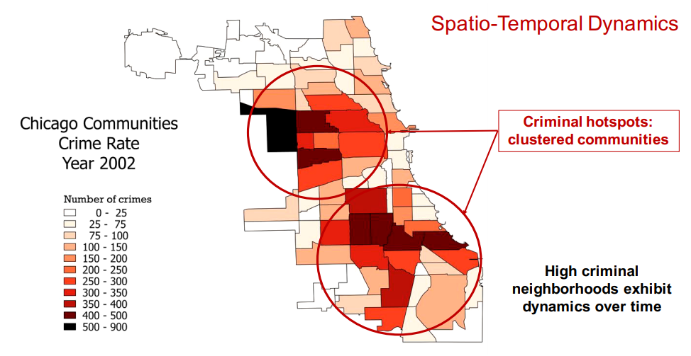
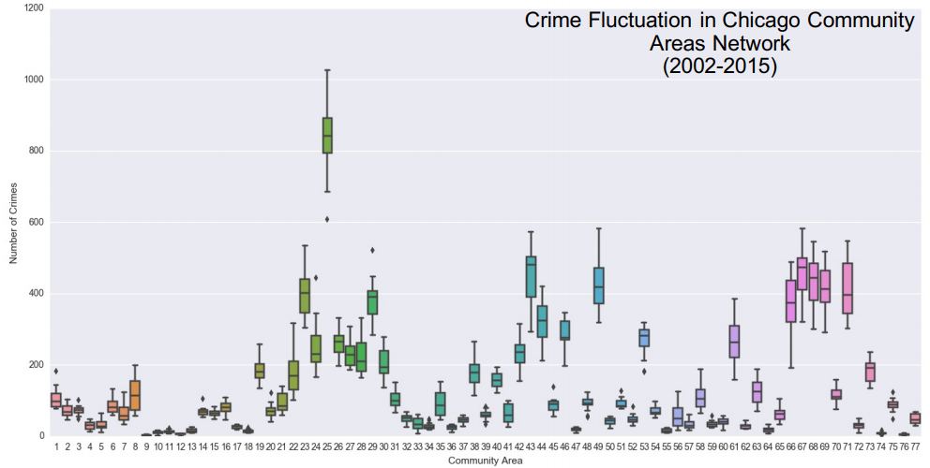
Preliminary look at data

Slide 7
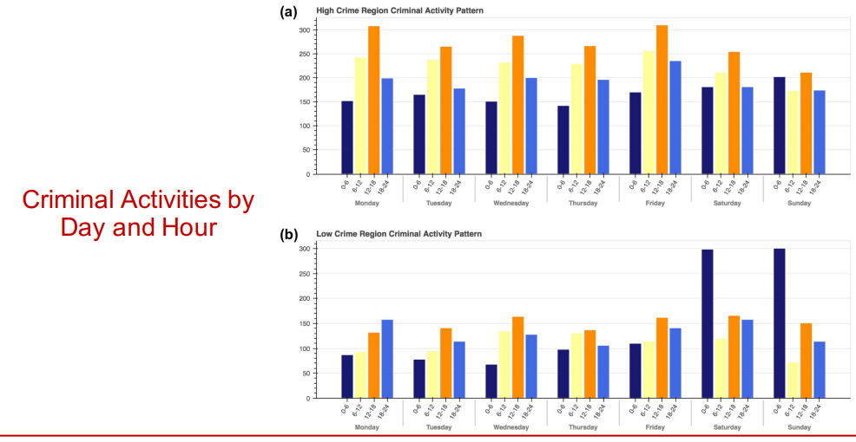
Preliminary look at data

Slide 8
Analyze feature relationships
Check for correlation between race, education, poverty rate, property ownership
Check for patterns year over year
Create community areas clustering
Do a correlation analysis using
Correlation Matrix
Threshold Visualizer (Yellow-brick)

Slide 9
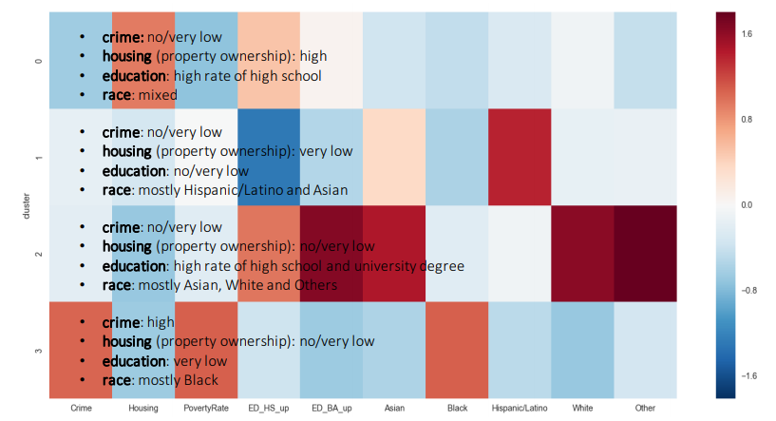
Relationships

Slide 10
Prepare data for model
Model 1: Apply K-means clustering to partition and minimize cluster sum of squares
Calculate Euclidean distance between data points
Model II: Apply Linear Regression to predict the number of crime incidents
Use number of crime incidents at location x and time y
Split – Train – Test
Using an 80%/20% Split
Train (80%)
Test (20%)
Check the clustering results
Precision Score
Recall Score

Slide 11
Hyper parameter tuning
Use yellowbrick to test the hyperparameters for the selected models
Identify the best hyperparameter values (e.g Alpha Selection)
Review model results (e.g. Grid Search)

Slide 12
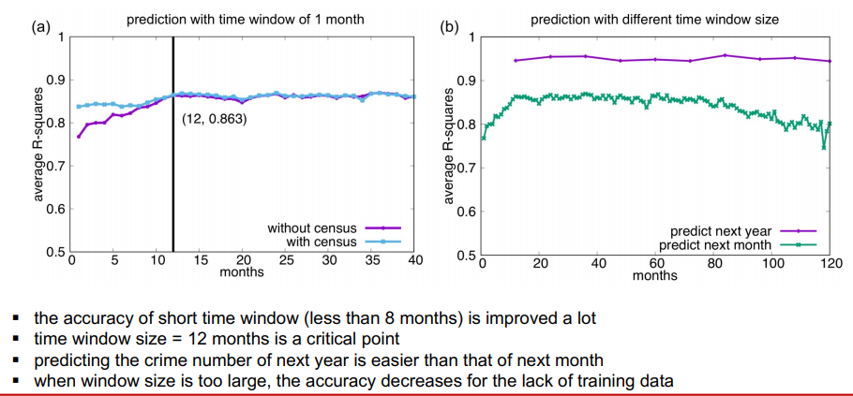
Regression report & Visualization

Slide 13
Results
Draw conclusion
Reveal dynamics of criminal hostpots
Show discovered patterns
Apply prediction model to forecast the number of crimes in certain areas

